Slide 2
OBJECTIVES
Reality check. Financial planners and their clients are both constrained by their decision-making biases.
3 Behavioral Finance biases affecting planners and their clients: Confirmation Bias, Overconfidence, and Loss Aversion.
Strategies for mitigating the effects of these specific biases, and cognitive biases in general.
Q and A.
References for further study

Slide 3
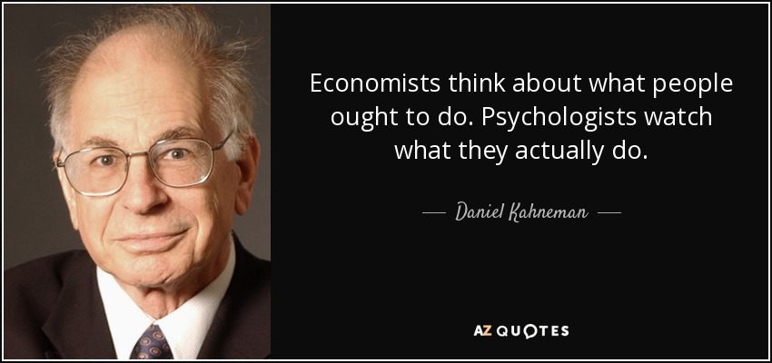

Slide 4
WE ARE NOT AS RATIONAL AS WE THINK WE ARE
If knowledge and data were sufficient to solve our problems, there would be no…
Obese Physicians
Divorced Marriage Counselors
Bankrupt Bankers
Indicted Attorneys
Tax liens against CPAs
Debt burdened Financial Advisors

Slide 5
WHAT’S YOUR ANSWER ?
I BELIEVE THE PORTFOLIO DECISIONS I MAKE FOR MY CLIENTS HELP THEM BEAT THE MARKET
___ Yes
___ No

Slide 6
WHAT’S YOUR ANSWER ?
Consider this opportunity. You can replace your existing portfolio with a new one. The new portfolio has a 50% probability (a coin flip) of providing a 50% real return over your lifetime. But the new portfolio also has a 50% probability that it will earn a negative real rate of return. What is the highest negative rate of return, N%, that you’d accept for this opportunity?
___ -5% < N < 0%
___ -10% < N < -5%
___ -20% < N < -10%
___ -30% < N < -20%
___ N < -30%

Slide 7
BEHAVIORAL BIASES OF FINANCIAL ADVISORS
Bias | Statement | % Agree
Loss Aversion | I then to feel twice as bad about a loss as I feel good about an equivalent gain | 82%
Overconfidence | I think my portfolio management skills can help clients outperform the market | 65%
Availability Bias | I tend to rely on information that is readily available or easily recallable | 58%
Confirmation Bias | I seek information that confirms my perception or current views | 54%
Recency Bias | I am influenced by recent news events or experiences when making investment decisions | 51%
Source: https://investmentsandwealth.org/getmedia/dea8bde8-2399-4534-b97f-541dd7e46123/Cerulli-whitepaper-Mitigating-the-Impact-of-Advisors-Behavioral-Biases-002.pdf

Slide 8
STUDIES CONFIRM ADVISOR BIASES
Advisors’ personal portfolios underperform passive benchmarks by the same amount as their clients’ portfolios. Annual risk adjusted alphas are -3.07% for clients and -3.66% for advisors. Financial planners and advisors often display the same biases when dealing with their clients. Many advisors chase returns and overtrade.

Slide 9
LOSS AVERSION
The pain of loss is greater than the joy of an equivalent gain
We are motivated to avoid a potential regret
Sunk Costs (Time, Energy, Money, Ego) motivate us to hold on to losses too long (Investments, Relationships, Clients)

Slide 10
OVERCONFIDENCE
The Good News - Bad News about being Smart
Confidence Bias applies to IQ and EQ
Clients Pay for Peace of Mind
They want you to be Confident…..and that’s the problem !

Slide 11
CONFIRMATION BIAS
We seek validation to support what we already believe.
Investors tend to seek information that confirms their prior views. If they are recommending a stock, they will tend to read articles that confirm their bullishness
Who and What are your sources for investment information? More importantly, why are they your sources?

Slide 12
CONTROLLING BIASES: YOU AND YOUR CLIENTS
Know your enemy: That’s you
Revisit and analyze your history of Good/Bad Decisions
Diversification works- Broaden your perspective- Seek out DISconfirming information
If possible, HALT the Decision: Being Hungry, Angry, Lonely, or Tired are emotional triggers
Confer with others you think are Wise, Sensible, and willing to challenge you; Seek Second opinions
Establish and follow benchmarks, plans, policies.
If you have trouble controlling your emotions, seek therapy.
Establish automatic, non emotional “nudges”… e.g., scheduled, monthly, forced savings, scheduled calls with clients

Slide 13
Q & A

